Slide 1

E-Commerce Shopping Cart System OOTs Using JAVA (BMICSE0352)
Department of Computer Science and Engineering
M.Tech Int.
(Submitted To: Ms.Aditee Mattoo Ma’am)
Group Members
Name of Member | Roll Number | Role | Department n Section
Team Lead Name | Deepak Agrawal | Front End Design | M.Tech (int.)
Team Member Name | Abhishek Kumar | Documentation | M.Tech (int.)
Team Member Name | Gopal Kumar | Back end, Database | M.Tech (int.)

Slide 2

Cartify: E-Commerce Shopping Cart Application
An E-Commerce Application using Java Swing

Slide 3

Index
Introduction
Literature Survey/Existing System
Problem Statement
Proposed Methodology
Feasibility Study
Hardware /Software Requirement
Results and Conclusion
References
Live Demonstration of Project
Feedback from the Panel

Slide 4
Introduction
In today’s digital era, e-commerce applications have revolutionized the way businesses operate and customers shop. Cartify is an innovative and user-friendly e-commerce application that facilitates shopping and managing a cart for users. It provides a seamless online shopping experience where users can browse products, add them to their cart, apply discount codes, and proceed with the checkout process.

Slide 5
Literature Survey/Existing System
Cartify is a simple, desktop-based shopping cart application.
It focuses on smaller-scale, niche e-commerce systems.
Key features include:
Adding/removing products.
Applying discounts.
Checkout functionality.
Unlike major platforms like Amazon, Flipkart, and eBay, Cartify offers basic
functionality for simplified online shopping.

Slide 6
Problem Statement
Cartify addresses the complexity of existing systems and aims for
simplicity.
It provides a user-friendly shopping experience.
Key features include:
Product browsing.
Cart management.
Discount application.
Designed to offer a basic, intuitive shopping interface.

Slide 7
Proposed Methodology
The system follows the Model-View-Controller (MVC) architecture:
- Model: Represents data (products, cart items).
- View: The user interface.
- Controller: Handles logic like adding/removing products, applying discounts, and processing checkout.
The system is designed using Java Swing for a responsive GUI.

Slide 8
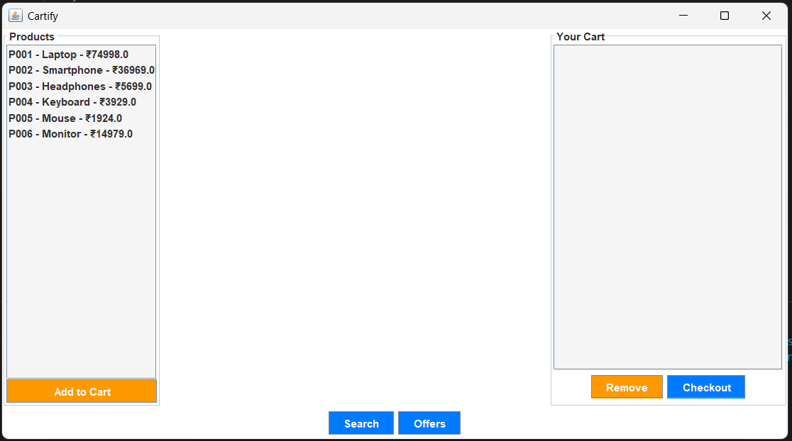
Overview-

Slide 9
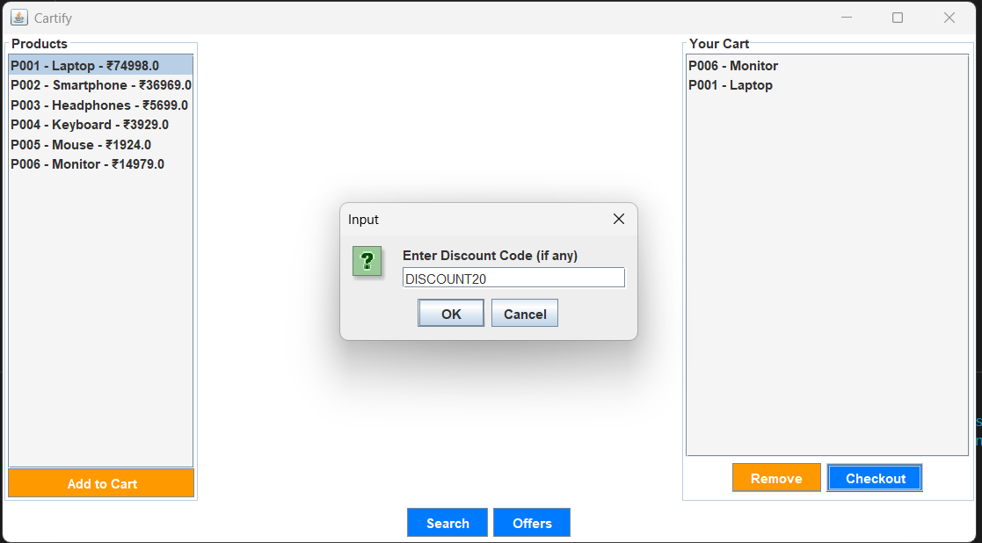
Discount-

Slide 10
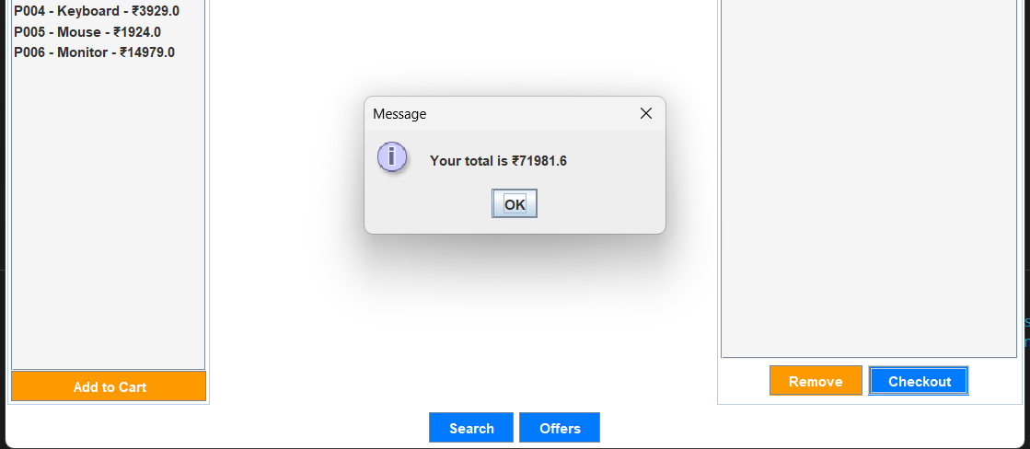
Confirmation of Total amount-

Slide 11
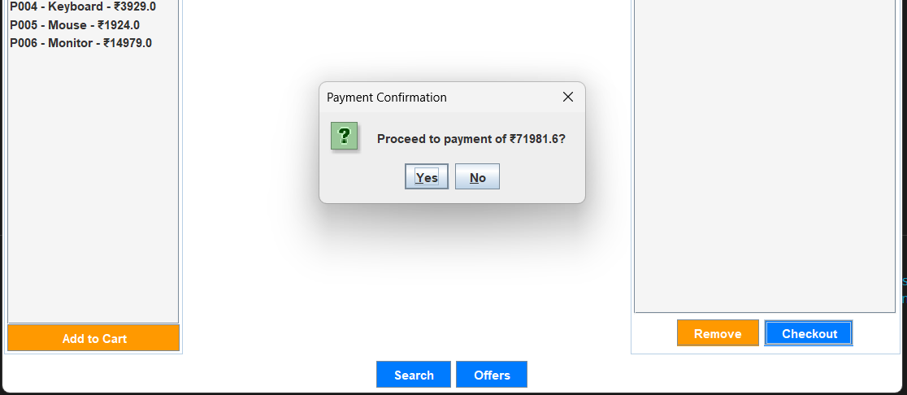
Payment confirmation-

Slide 12
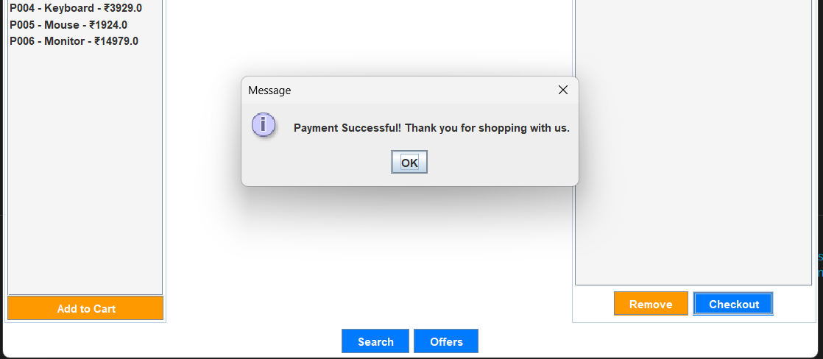
Completion-

Slide 13
Feasibility Study
Technical Feasibility: Java Swing is a suitable cross-platform tool for creating GUI-based applications. Cartify requires minimal hardware resources.
Economic Feasibility: The application is cost-effective, requiring no expensive server infrastructure.
Operational Feasibility: The system is easy to use, making it accessible to a wide range of users.

Slide 14
Hardware /Software Requirement
Hardware Requirements:
- Processor: Intel Core i3 or equivalent
- RAM: 4 GB or higher
- Disk: 100 MB free space
Software Requirements:
- Operating System: Windows, Linux, Mac OS
- JDK: Version 8 or higher
- IDE: IntelliJ IDEA, Eclipse

Slide 15
Results and Conclusion
Cartify demonstrates essential functionality of an online shopping
cart system.
The user interface is simple and easy to navigate.
Key features include:
Adding/removing items.
Applying discounts.
Smooth checkout process.
The system can be extended to include payment gateways and
other advanced features.

Slide 16
References
Java: Official java Documentation(oracle)
Design Patterns: Erich Gamma et al.
Introduction to E-Commerce Systems, E. Turban
Software Engineering Principles, Ian Sommerville

Slide 17
Live Demonstration of Project
The live demonstration will showcase the following:
- Adding/removing products to/from the cart
- Applying discount codes
- Checkout process simulation

Slide 18




Feedback from the Panel
Feedback will be provided on the following aspects:
- User Interface
- Functionality
- Scalability and performance

Slide 19
Thank You

